Slide 1
Smart water management
-By using IOT (Internet of Things)

Slide 2
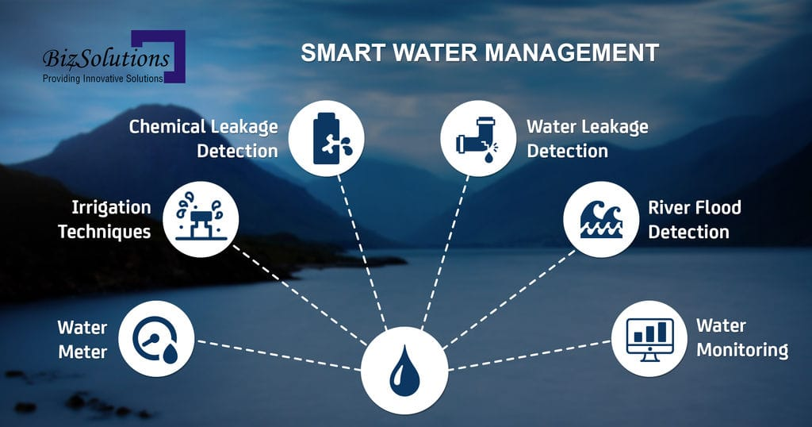

Slide 3
Objectives:
Sure, here are some key points to consider when defining objectives for a smart water management project:
1. *Efficient Resource Allocation:* Aim to optimize the allocation of water resources, ensuring that water is distributed in an effective and sustainable manner.
2. *Real-Time Monitoring and Analysis:* Implement systems for real-time monitoring and analysis of water usage, quality, and distribution to identify areas of improvement and potential issues.
3. *Reduction of Water Loss:* Develop strategies to minimize water loss through leakage detection, pipeline maintenance, and efficient water distribution systems.
4. *Sustainable Water Use:* Promote sustainable water usage practices, such as rainwater harvesting, wastewater recycling, and the use of water-saving technologies, to ensure long-term resource availability.
5. *Enhanced Data Management:* Establish a comprehensive data management system to collect, store, and analyze water-related data for informed decision-making and long-term planning.

Slide 4
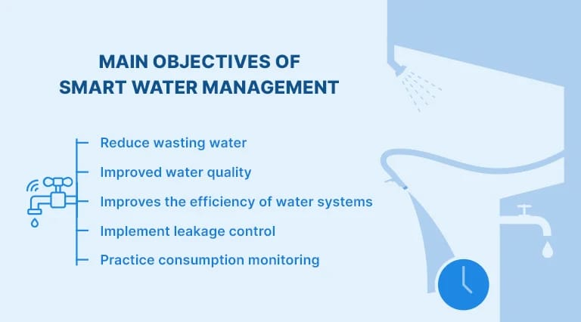

Slide 5
6. *Community Engagement and Education:* Encourage community participation and awareness through educational programs and outreach initiatives to promote responsible water usage and conservation.
7. *Integration of IoT and Automation:* Incorporate IoT devices and automation technologies to enable remote monitoring, control, and management of water infrastructure for increased efficiency and reduced operational costs.
8. *Resilience to Climate Change:* Develop strategies to address the challenges posed by climate change, including droughts, floods, and water scarcity, by implementing adaptive measures and resilient water management practices.
9. *Policy Alignment and Compliance:* Ensure that the project aligns with local and national water management policies and regulations, fostering compliance and accountability for sustainable water resource management.
10. *Cost-Effectiveness and Long-Term Sustainability:* Strive to achieve cost-effective solutions that not only meet immediate needs but also ensure the long-term sustainability of water resources, fostering economic and environmental stability.

Slide 6
Iot device set up:
Certainly, here are some key points to consider when setting up a smart water management project:
1. *Assessment and Planning:* Conduct a comprehensive assessment of the current water management system and develop a detailed plan that outlines the specific objectives, timelines, and resource requirements for the project.
2. *Technological Infrastructure:* Establish a robust technological infrastructure that includes sensors, meters, data collection devices, and communication networks to enable effective data gathering and monitoring of water usage and distribution.
3. *Data Integration and Management:* Implement a centralized data management system that integrates data from various sources, allowing for efficient storage, analysis, and visualization of water-related information for informed decision-making
4. *Partnership and Collaboration:* Foster partnerships with relevant stakeholders, including local authorities, water utility companies, technology providers, and community organizations, to leverage expertise and resources for successful project implementation.
5. *Training and Capacity Building:* Provide training programs and capacity-building initiatives for staff and community members to ensure they are equipped with the necessary skills to operate and maintain the smart water management infrastructure effectively.

Slide 7
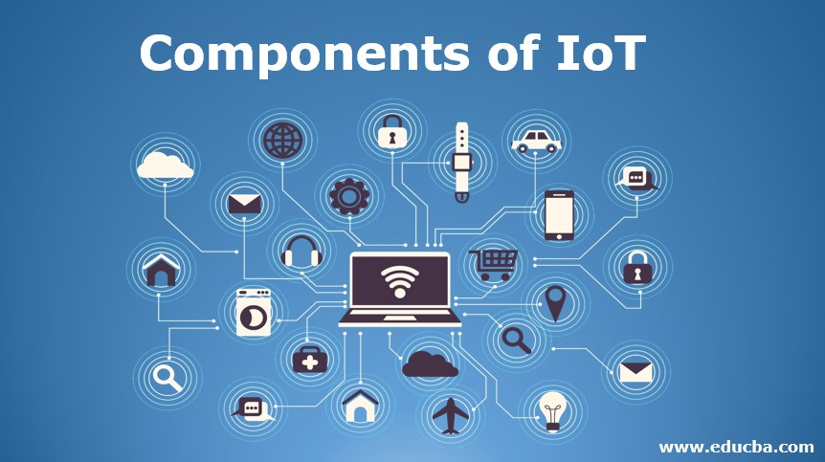

Slide 8
6. *Community Engagement and Education:* Encourage community participation and awareness through educational programs and outreach initiatives to promote responsible water usage and conservation.
7. *Integration of IoT and Automation:* Incorporate IoT devices and automation technologies to enable remote monitoring, control, and management of water infrastructure for increased efficiency and reduced operational costs.
8. *Resilience to Climate Change:* Develop strategies to address the challenges posed by climate change, including droughts, floods, and water scarcity, by implementing adaptive measures and resilient water management practices.
9. *Policy Alignment and Compliance:* Ensure that the project aligns with local and national water management policies and regulations, fostering compliance and accountability for sustainable water resource management.
10. *Cost-Effectiveness and Long-Term Sustainability:* Strive to achieve cost-effective solutions that not only meet immediate needs but also ensure the long-term sustainability of water resources, fostering economic and environmental stability.

Slide 9
Platform development:
Certainly, here are some key points to consider when developing a smart water management project using an IoT platform:
1. *IoT Infrastructure Planning:* Design a scalable and reliable IoT infrastructure that includes sensors, actuators, gateways, and communication protocols, ensuring seamless data transmission and connectivity across the water management network.
2. *Sensor Deployment Strategy:* Strategically deploy a variety of sensors, such as flow meters, water quality sensors, and leak detectors, in critical locations to enable real-time data collection and monitoring of key water parameters.
3. *Data Integration and Analysis:* Develop an integrated data management system that efficiently collects, stores, and analyzes data from IoT devices, allowing for the generation of actionable insights and data-driven decision-making in water management operations.
4. *Cloud-Based Platform Development:* Build a secure and robust cloud-based platform that enables the storage, processing, and visualization of large volumes of data, facilitating remote access and control of the smart water management system from any location.

Slide 10
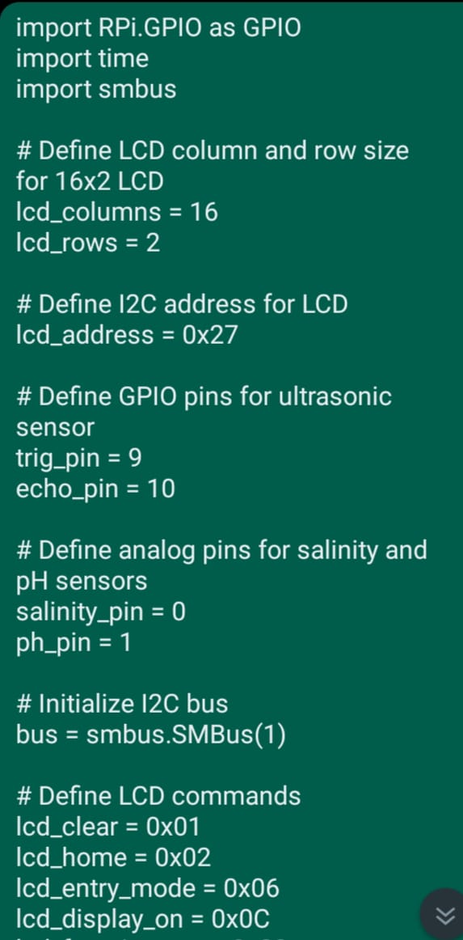
Coding for arduino (python script):

Slide 11
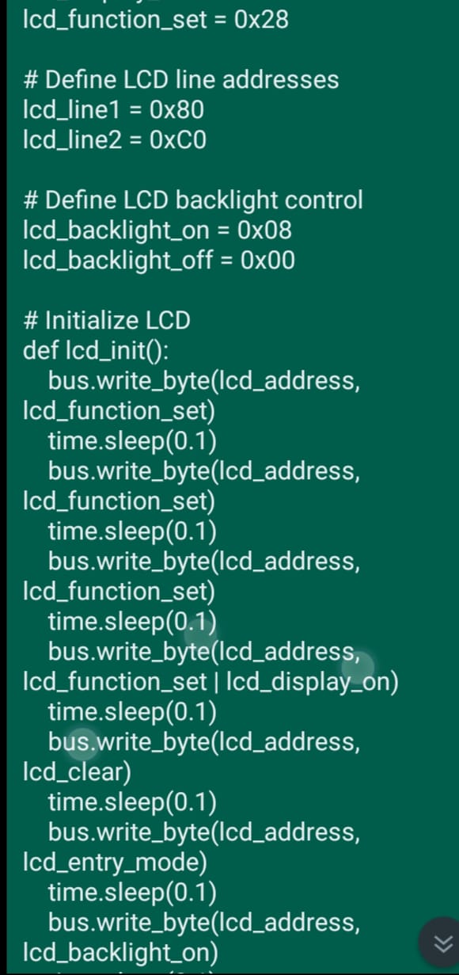

Slide 12
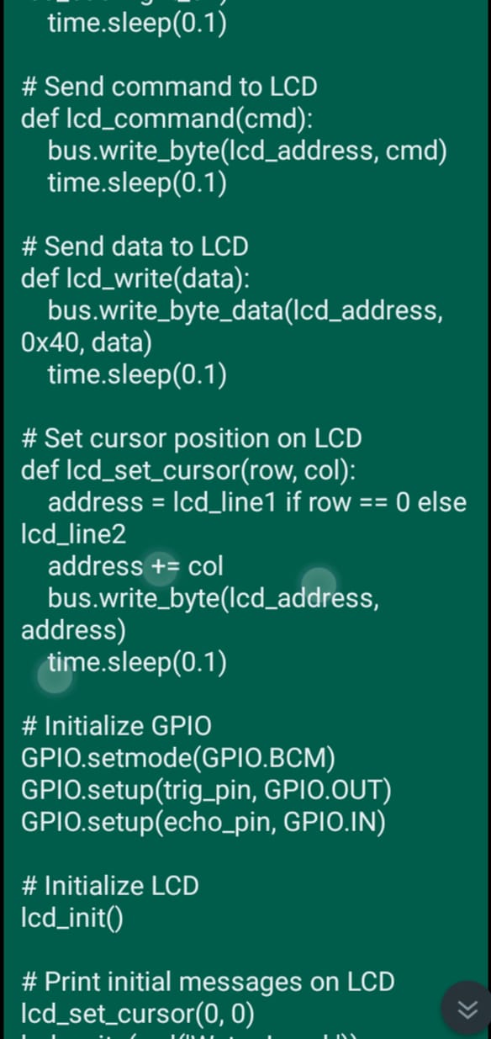

Slide 13
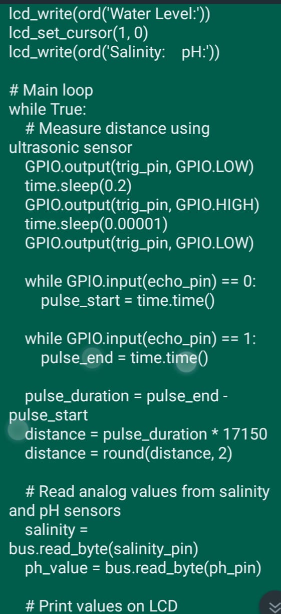

Slide 14
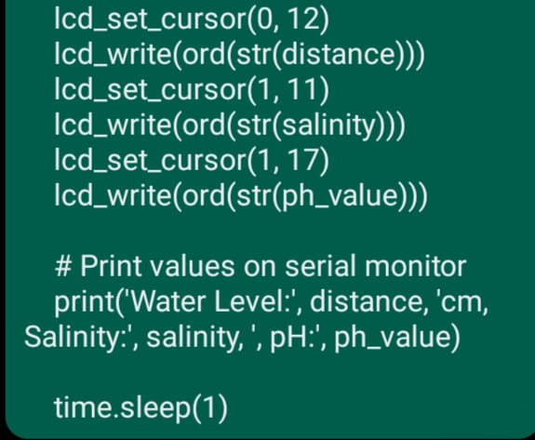

Slide 15
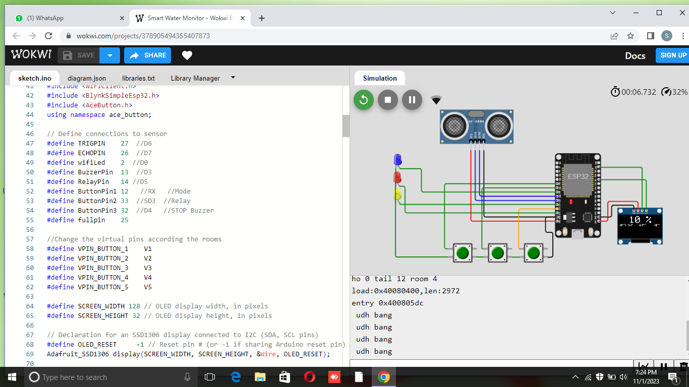
Stimulation model:

Slide 16
5. *Application Development for User Interface:* Create user-friendly applications and interfaces that allow stakeholders to access real-time data, receive alerts, and control water management systems, fostering improved decision-making, operational efficiency, and user engagement.
6. *Security and Privacy Measures:* Implement stringent security protocols and privacy measures to safeguard the IoT network and data from cyber threats, ensuring the integrity and confidentiality of sensitive information related to water usage and distribution.
7. *Remote Monitoring and Control:* Enable remote monitoring and control functionalities through the IoT platform, allowing operators to remotely manage water infrastructure, detect anomalies, and initiate timely responses to ensure optimal system performance and minimize water wastage.
8. *Data Visualization and Reporting:* Develop comprehensive data visualization tools and reporting mechanisms that present data insights in a clear and actionable format, facilitating the identification of trends, patterns, and areas for improvement in water management practices.

Slide 17
9. *Scalability and Flexibility:* Design the IoT platform to be scalable and adaptable to accommodate future expansions, technological advancements, and changing requirements in the smart water management domain, ensuring long-term sustainability and relevance of the project.
10. *Interoperability and Standardization:* Ensure interoperability and adherence to industry standards for data exchange and communication protocols, allowing seamless integration with other IoT devices, platforms, and existing water management systems for enhanced operational efficiency and data interoperability.

Slide 18
Schematics:
Certainly, here are some key points to consider when implementing an IoT-based smart water management project using schematics:
1. *Sensor Integration:* Incorporate various sensors, such as water level sensors, flow sensors, and quality sensors, into the water management system to gather data on water usage, distribution, and quality parameters.
2. *Microcontroller Selection:* Choose appropriate microcontrollers, such as Arduino or Raspberry Pi, to process sensor data and control actuators based on predefined logic and algorithms, ensuring efficient and timely responses to changing water management conditions.
3. *Actuator Control Mechanisms:* Implement actuator control mechanisms, including valves, pumps, and gates, to enable automated adjustments and interventions in the water distribution system based on real-time data inputs and predefined thresholds.

Slide 19
4. *Communication Protocols:* Select reliable communication protocols, such as MQTT or LoRa, to facilitate seamless data transmission between sensors, microcontrollers, and the central management system, ensuring continuous monitoring and control of the water management infrastructure.
5. *Power Management Solutions:* Incorporate efficient power management solutions, such as solar panels, battery backups, or energy harvesting techniques, to ensure uninterrupted operation of the IoT-based water management system, particularly in remote or off-grid locations.
6. *Data Processing and Analysis:* Develop data processing and analysis algorithms within the microcontroller or a connected central server to derive actionable insights from the collected data, facilitating informed decision-making and optimized water management strategies.

Slide 20
7. *Remote Access and Control:* Enable remote access and control of the IoT-based system through secure connections and authentication mechanisms, allowing authorized personnel to monitor system performance, adjust settings, and respond to emergencies from a centralized location.
8. *Redundancy and Fail-Safe Mechanisms:* Implement redundancy and fail-safe mechanisms within the IoT architecture to mitigate the risk of system failures, ensuring that backup systems or alternative communication pathways are available in case of primary system malfunctions.
9. *User Interface Development:* Create a user-friendly interface, such as a web dashboard or mobile application, that provides stakeholders with real-time insights, alerts, and controls, enabling efficient management and oversight of the smart water management system.
10. *Regular Maintenance and Upgrades:* Establish a schedule for regular maintenance and upgrades to ensure the longevity and optimal performance of the IoT-based water management infrastructure, including software updates, sensor calibrations, and hardware inspections to prevent operational disruptions and maintain data accuracy.

Slide 21
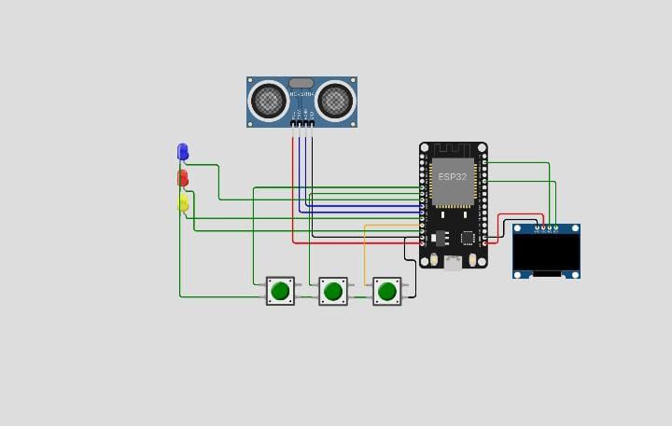
Circuit diagram:

Slide 22
Html coding for web development:
<!DOCTYPE html>
<html lang="en">
<head>
<meta charset="UTF-8" />
<meta name="viewport“
content="width=device-width,
initial-scale=1.0" />
<title>Water Management</title>
</head>

Slide 23
<style> #locationBlock {
flex-direction: row nowrap;
display: flex;
gap: 150px;
box-shadow: 1px 4px 30px 1px;
margin: 40px;
justify-content: center;
}
#parentElement {
background-color: white; }

Slide 24
#pumpButton {
padding: 10px;
padding-left: 20px;
padding-right: 20px;
background-color: blue;
border-radius: 15px 15px 15px
15px;
margin-left: 20px;
color: whitesmoke;
font-weight: 600;
}
#Chennai {
color: black;
margin: 2px;
}

Slide 25
#currentElement {
flex-direction: row nowrap;
display: flex;
gap: 150px;
box-shadow: 1px 4px 30px 1px;
margin: 40px;
justify-content: center;
}
#Header {
width: 100%;
display: flex;
justify-content: center;
flex-direction: row nowrap;
font-weight: 900;
font-size: xx-large;
color: gray;
}

Slide 26
</style>
<body onload="hideElement()">
<div id="Header">Water Management</div>
<div id="parentElement">
<div id="locationBlock">
<div id="Chennai">
<h3 id="chennaiCity">Chennai</h3> <p id="chennaiSensor">Sensor Data: 3</p> <p id="chennaiWaterLevel">Current Water Level(ft): 74.23</p>
<button id="pumpButton" onclick="startPumping('Chennai')"> Start Pump
</button>
</div>

Slide 27
<div id="">
<h3 id="MaduraiCity">Madurai</h3>
<p id="maduraiSensor">Sensor Data: 23.30</p>
<p
id="maduraiWaterLevel">Current Water Level(ft): 24.44</p> <button id="pumpButton" onclick="startPumping('Madurai')"> Start Pump
</button>
</div>
<div id="">
<h3 id="RamanathapuramCity">Ramanathapuram</h3>
<p
id="ramnadSensor">Sensor Data: 16.19</p> <p id="ramnadWaterLevel">Current Water Level(ft): 2.05</p> <button id="pumpButton" onclick="startPumping('Ramanathapuram')">
Start Pump
</button>
</div>

Slide 28
<div id="">
<h3
id="TirunelveliCity">Tirunelveli</h3>
<p id="tirunelveliSensor">Sensor Data: 12.33</p>
<p
id="tirunelveliWaterLevel">Current Water Level(ft): 12.03</p> <button id="pumpButton" onclick="startPumping('Tirunelveli')"> Start Pump
</button>
</div>
</div>

Slide 29
<div id="currentElement">
<p id="City"></p>
<p id="Sensor"></p>
<p id="WaterLevel"></p>
</div>
</div>
<script>
function startPumping(city) {
var _element = document.getElementById("currentElement"); _element.style.display = "block"; _element.style.display = "flex";

Slide 30
if (city === "Chennai") {
var _currentCity = document.getElementById("chennaiCity").innerHTML;
var _currentSensor = document.getElementById("chennaiSensor").innerHTML;
var _currentWaterLevel = document.getElementById("chennaiWaterLevel").innerHTML; document.getElementById("City").innerHTML = _currentCity; document.getElementById("Sensor").innerHTML = _currentSensor; document.getElementById("WaterLevel").innerHTML = _currentWaterLevel;

Slide 31
} else if (city === "Madurai") {
var _currentCity = document.getElementById("MaduraiCity").innerHTML;
var _currentSensor = document.getElementById("maduraiSensor").innerHTML;
var _currentWaterLevel = document.getElementById("maduraiWaterLevel").innerHTML; document.getElementById("City").innerHTML = _currentCity; document.getElementById("Sensor").innerHTML = _currentSensor; document.getElementById("WaterLevel").innerHTML = _currentWaterLevel; } else if (city === "Tirunelveli") {

Slide 32
var _currentCity = document.getElementById("TirunelveliCity").innerHTML;
var _currentSensor = document.getElementById("tirunelveliSensor").innerHTML;
var _currentWaterLevel = document.getElementById("tirunelveliWaterLevel").innerHTML; document.getElementById("City").innerHTML = _currentCity; document.getElementById("Sensor").innerHTML = _currentSensor; document.getElementById("WaterLevel").innerHTML = _currentWaterLevel; } else if (city === "Ramanathapuram") {

Slide 33
var _currentCity = document.getElementById("RamanathapuramCity").innerHTML;
var _currentSensor = document.getElementById("ramnadSensor").innerHTML;
var _currentWaterLevel = document.getElementById("ramnadWaterLevel").innerHTML; document.getElementById("City").innerHTML = _currentCity; document.getElementById("Sensor").innerHTML = _currentSensor; document.getElementById("WaterLevel").innerHTML = _currentWaterLevel; } }

Slide 34
function hideElement(){
}
</script>
</body>
</html>

Slide 35
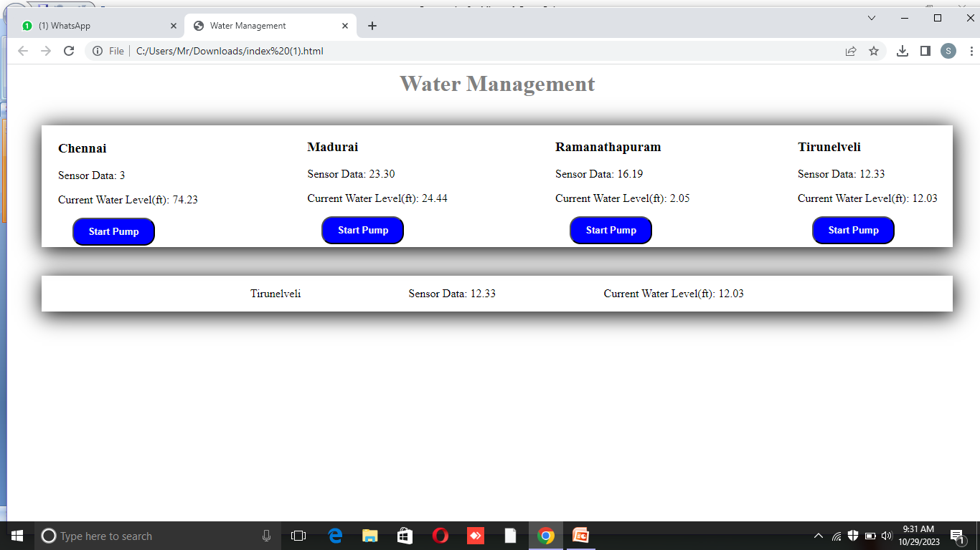

Slide 36



Slide 37



Slide 39
Working principle
The smart water management system project generally operates based on several key principles, including:
*Sensor Technology:* Utilizes various sensors to monitor water quality, levels, and flow rates in real-time.
2. *Data Collection and Analysis:* Gathers data from sensors and uses analytics to identify patterns, trends, and potential issues in water usage.
3. *Automation and Control Systems:* Implements automated control systems to optimize water usage, reduce wastage, and ensure efficient distribution.
4. *Internet of Things (IoT) Integration:* Connects devices and systems through IoT, allowing for remote monitoring and control of water management operations.

Slide 40
5. *Remote Access and Monitoring:* Enables users to access and monitor the system remotely through mobile apps or web interfaces, ensuring real-time oversight and control
6. *Predictive Maintenance:* Utilizes predictive algorithms to anticipate maintenance requirements and prevent potential failures, thereby ensuring the continuous operation of the system.
7. *Data Visualization and Reporting:* Presents data in a user-friendly format through visualizations and reports, facilitating better decision-making for stakeholders and authorities.

Slide 41
8. *Water Conservation Strategies:* Implements strategies such as leak detection, water usage optimization, and sustainable water management practices to promote conservation and sustainability.By incorporating these key elements, the smart water management system enhances operational efficiency, minimizes water wastage, and promotes sustainable water usage practices.

Slide 42
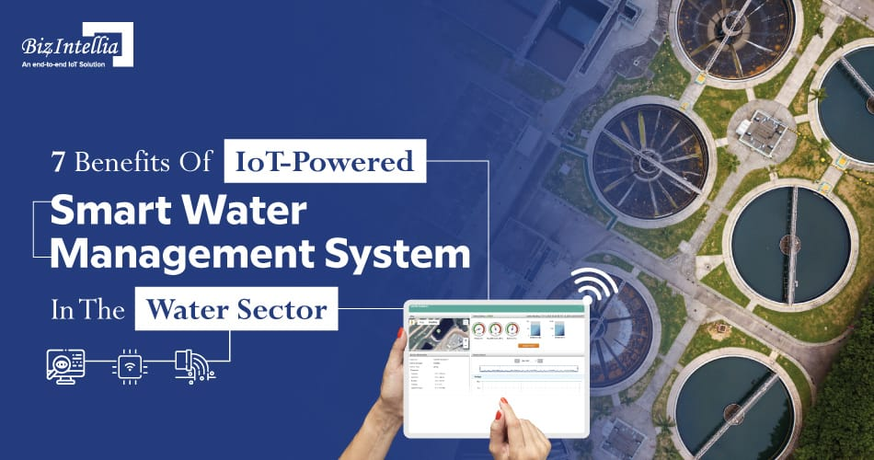

Slide 43
Benefits:
Smart water management systems offer various benefits, including:
1. *Resource Conservation*: These systems help in conserving water by efficiently managing usage, reducing wastage, and identifying leaks or issues in the water supply network.
2. *Cost Savings*: By minimizing water loss and optimizing usage, smart water management systems can lead to significant cost savings for both consumers and water utilities.
3. *Data-Driven Insights*: They provide valuable data on water consumption patterns, helping in making informed decisions about infrastructure improvements and resource allocation.
4. *Remote Monitoring and Control*: These systems allow for remote monitoring and control of water supply networks, enabling quick responses to issues and reducing the need for physical inspections.

Slide 44
5. *Improved Infrastructure Efficiency*: With real-time data and insights, these systems facilitate proactive maintenance, which enhances the overall efficiency and longevity of water infrastructure.
6. *Environmental Impact Reduction*: Efficient water management reduces the environmental impact of water usage by promoting sustainable practices and minimizing the energy required for water treatment and distribution.
7. *Resilience to Climate Change*: Better preparedness for and adaptation to the impacts of climate change on water resources through data-driven insights and adaptive strategies.

Slide 45
Smart water management in farming sector
Implementing a smart water management project using IoT in the farming sector involves several key points, including:
1. Sensor Deployment: Installing IoT sensors to monitor soil moisture, temperature, and humidity levels in real-time.
2. Data Analytics: Utilizing data analytics to assess the collected information and make informed decisions about irrigation schedules and water usage.
3. Automated Irrigation: Using IoT devices to automate irrigation systems based on data insights, optimizing water usage and ensuring efficient crop growth.
4. Remote Monitoring: Enabling farmers to remotely monitor and control irrigation systems through mobile applications or web interfaces, allowing for timely adjustments as needed.

Slide 46


Slide 47
5. Predictive Maintenance: Implementing predictive maintenance strategies for water pumps, filters, and other equipment to prevent breakdowns and ensure continuous operation.
6. Water Quality Monitoring: Incorporating IoT devices to monitor water quality, ensuring that the water used for irrigation is suitable for crop growth and does not contain harmful contaminants.
7. Cloud Integration: Storing and analyzing data in the cloud, facilitating easy access to historical data and enabling comprehensive analysis for long-term planning and decision-making.
8. Cost Optimization: Utilizing IoT data to optimize water usage, reduce operational costs, and improve overall resource management, leading to higher agricultural productivity and profitability.

Slide 48
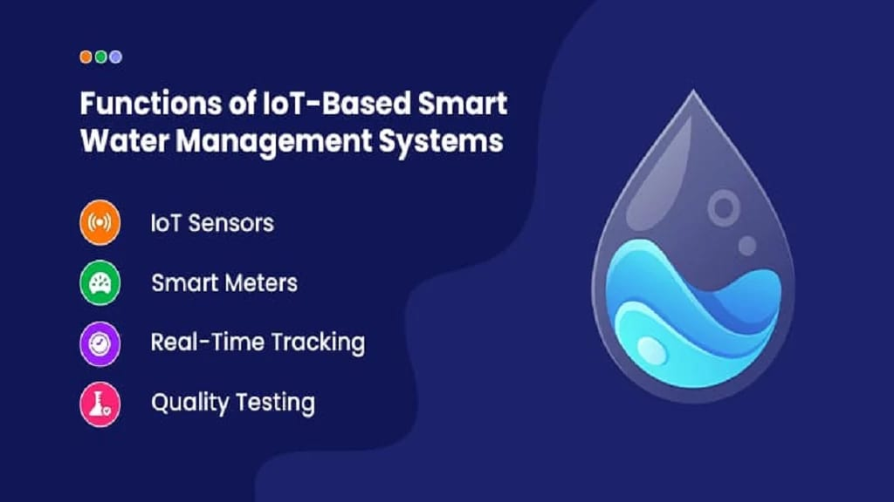

Slide 49
overview about project:
A smart water management project typically involves the integration of technology to monitor, conserve, and optimize water usage. It often includes elements like IoT sensors, data analytics, and automated systems to enhance water distribution, usage, and conservation. The key objectives typically revolve around improving efficiency, reducing wastage, and promoting sustainability in water usage. These projects can encompass various aspects, including smart irrigation systems, leak detection, water quality monitoring, and real-time data analysis to ensure effective water resource management.

Slide 50


